Slide 1
Fours Trainer Project Plan
Vikas Sanil (VSANIL1@hawk.iit.edu)

Slide 2
SCOPE
FOURS Trainer audible android application will be for children between ages 1-4. The application will help children’s brain development by exposing them to all worldwide children’s stories in their native language.
As part of phase one, we will catalog children’s stories from Europe and make them available in English and Mandarin. We are targeting to record at least 100 stories and release the Android app in the next 6 months.
We will make 5 stories available for free and charge a one-time premium of $6 for a subscription to the rest of the stories.
In-scope: Android application will allow users to scroll through the story list and play it for their kid. Users can subscribe for more stories. We will mention the Source of the story and the author’s name if known.
Out of scope: We will not display the closed caption or text for parents to read along with the audio. No advertisement placement.

Slide 3
How
Agile methodology
We will be using 2 weeks agile scrum sprint to deliver the most viable product as early as possible to the focus group users and get feedback to improve the product before releasing the full product at the end of 6 months. Every 2-weekss sprint will start on Tuesday and end on next week Friday.
Team
UX Designer($60/hour), Language Expert($60/hour), Sound Recording Expert($60/hour), Android Developer($50/hour), Payment Service Expert($50/hour), Android App Test Engineer($50/hour), Operation Engineer($50/hour), Product Manager($60/hour), and Scrum Master($60/hour).
Funding
Galactic Republic will be funding this project. The overall amount allocated for this project is $5,000,000. We will get $600,000 for phase one.
Technology stack
Android Studio, Selenium, Docker, GIT, Jenkin, JIRA, Confluence, Audacity/Podbean.

Slide 4
Financials
Value
Cost
The project is for profit. Targeted subscribers in 1st year 10,000, 40,000 in 2nd-year, 3rd- year, and 4^{th-}year at a $6 one-time subscription fee for English and Mandarin language.
1st year =$10*10,000 =$100,000
2nd year, 3rd year, and 4th year =$10*40,000 =$400,000
Total revenue end of 4th year = $1,300,000
Total team member cost: $500/hour*8hour/day*5days/week*26week = $520,000
Software cost:
Around $10,000 for 6 months subscription.
Net Present Value
At 20% return, NPV = 100,000 + 400,000 +400,000 +400,000
(1+0.20)¹ (1+0.20)² (1+0.20)³ (1+0.20)⁴
= $83,333.33+$277,777.78+$231,481.48+$192,901.23
= $785,493.82

Slide 5
Time
The project is scheduled for 6 months; hence we will have 13 sprints. Following are the goals to achieve at the end of each sprint.
Sprint 1:
Product Manager, UX Designers, and Android developers will develop a prototype of the app.
Language expert and Sound recording expert will have 5 stories ready in English.
Payment service expert will develop a payment gateway for the application with Google Pay.
Operation Engineer and Android App Test Engineer will set up the development and test environments/servers.
Sprint 2:
Android developers and UX designers will integrate payment services and stories prepared from the previous sprint in the app.
Language expert and Sound expert will have 5 stories ready in Mandarin.
Payment service expert will develop a payment gateway with Visa credit card payments.
Operation Engineer and Android App Test Engineer will set up the staging and production environments/servers.
Sprint 3:
Android Test Engineer will test the product developed in the previous sprints.
Android developers and UX designers will integrate payment services and stories prepared from the previous sprint in the app.
Language expert and Sound recording expert will have 20 stories ready in English.
Payment service expert will develop a payment gateway with Master credit card payments.
Operation engineer will deploy the app developed in the previous sprint in development and test environments/servers.

Slide 6
time
Sprint 4:
UX Designer will provide a demo to the Product Manager.
Android Test Engineer will test the product developed in the previous sprint.
Android developers and UX designers will integrate payment services and stories prepared from the previous sprint in the app.
Android developers fix issues identified by Android Test Engineer in the last Sprint.
Language expert and Sound recording expert will have 20 stories ready in Mandarin.
Payment service expert will develop a payment gateway with Discover credit card payments.
Operation engineer will deploy the app developed in the previous sprint in development and test environments/servers.
Operation engineer will deploy the app tested in the previous sprint in staging and production environments/servers.
Sprint 5:
Product Manager provides a demo to focus group users for the first 5 stories in English and Mandarin.
Android Test Engineer will test the product developed in the previous sprint.
Android developers and UX designers will integrate payment services and stories prepared from the previous sprint in the app.
Android developers fix issues identified by Android Test Engineer in the last Sprint.
Language expert and Sound recording expert will have 25 stories ready in English.
Payment service expert will develop a payment gateway with American Express credit card payments.
Operation engineer will deploy the app developed in the previous sprint in development and test environments/servers.
Operation engineer will deploy the app tested in the previous sprint in staging and production environments/servers.

Slide 7
time
Sprint 6:
Product Manager gathers and analyses feedback from the focus group users.
Android Test Engineer will test the product developed in the previous sprint.
Android developers and UX designers will integrate payment services and stories prepared from the previous sprint in the app.
Android developers fix issues identified by Android Test Engineer in the last Sprint.
Language expert and Sound recording expert will have 25 stories ready in Mandarin.
Payment service expert will develop a payment gateway with debit credit card payments.
Operation engineer will deploy the app developed in the previous sprint in development and test environments/servers.
Operation engineer will deploy the app tested in the previous sprint in staging and production environments/servers.
Sprint 7:
All team members will go through the feedback provided by the focus group and brainstorm solutions and improvements that can be made to the Android application.
Implement the solutions and improvements to the application.
Product Manager demos the optimized application to the focus group.
Sprint 8:
Android Test Engineer will test the product developed in sprint 6.
Android developers and UX designers will integrate payment services and stories prepared from sprint 6 in the app.
Android developers fix issues identified by Android Test Engineer in the last Sprint.
Language expert and Sound recording expert will have 25 stories ready in English.
Payment service expert will enhance all the payment gateway to provide a seamless user experience.
Operation engineer will deploy the app developed in sprint 6 in development and test environments/servers.
Operation engineer will deploy the app tested in sprint 9 in staging and production environments/servers.

Slide 8
time
Sprint 9:
Product Manager gathers and analyses feedback from the focus group users.
Android Test Engineer will test the product developed in the previous sprint.
Android developers and UX designers will integrate payment services and stories prepared from the previous sprint in the app.
Android developers fix issues identified by Android Test Engineer in the previous Sprint.
Language expert and Sound recording expert will have 25 stories ready in Mandarin.
Payment service expert will fix any issue related to the payment gateway.
Operation engineer will deploy the app developed in the previous sprint in development and test environments/servers.
Operation engineer will deploy the app tested in the previous sprint in staging and production environments/servers.
Sprint 10:
All team members will go through the feedback provided by the focus group and brainstorm solutions and improvements that can be made to the Android application.
Implement the solutions and improvements to the application.
Product Manager demos the optimized application to the focus group.
Sprint 11:
Android Test Engineer will test the product developed in sprint 9.
Android developers and UX designers will integrate payment services and stories prepared from sprint 9 in the app.
Android developers fix issues identified by Android Test Engineer in the last Sprint.
Language expert and Sound recording expert will have 25 stories ready in English.
Payment service expert will enhance all the payment gateway to provide a seamless user experience.
Operation engineer will deploy the app developed in sprint 9 in development and test environments/servers.
Operation engineer will deploy the app tested in sprint 9 in staging and production environments/servers.

Slide 9
time
Sprint 12:
Product Manager gathers and analyses feedback from the focus group users.
Android Test Engineer will test the product developed in the previous sprint.
Android developers and UX designers will integrate payment services and stories prepared from the previous sprint in the app.
Android developers fix issues identified by Android Test Engineer in the last Sprint.
Language expert and Sound recording expert will have 25 stories ready in Mandarin.
Payment service expert will fix any issue related to the payment gateway.
Operation engineer will deploy the app developed in the previous sprint in development and test environments/servers.
Operation engineer will deploy the app tested in the previous sprint in staging and production environments/servers.
Sprint 13:
All team members will go through the feedback provided by the focus group and brainstorm solutions and improvements that can be made to the Android application.
Implement the solutions and improvements to the application.
Release the Android application in Google Store.

Slide 10
Monitor and Control
We will monitor the Key Performance Indicators (KPIs), which are the goals set for each agile scrum sprint, the effort lost in each sprint, the cost of each sprint, and the feedback given by the focus group during Sprint 6 and 9.
We will control project progress based on the goals defined for each sprint. Any slippage will be communicated to the Business team and would require their approval to continue further with the project.
Any change to sprint goals would require the Business team’s approval and budget allocation as a new project.
Every project team member will attend morning stand-up at 10:00 am and provide updates in the following order – Any blockers, How much you completed yesterday’s goals, and What are your goals for today. If not able to attend, then there should be a status sent to the Scrum Master 1hr before the stand-up.

Slide 11
Quality metrics
The team will demonstrate their work to the Product Manager and Business team(optional) after every Sprint(on Monday).
End of Sprint 6 and Sprint 9, the Product Manager will share the feedback from the focus group with the Business team.
The Business team will be involved in Sprint 7 and Sprint 10 to review and approve the enhancements or solutions provided by the team. (*During this process Business team hours will not be charged on the project).
The team is expected to maintain the status of each story “current” with clear comments explaining what is completed, what is being worked on, and any blocking issues.
The Language Expert, Sound Engineer, and Payment Service Engineer will assign their stories to Android developers once completed.
Android developer will assign their stories to Android Test Engineer once completed.
The team will hand over stories to Product Manager for final user acceptance.

Slide 12
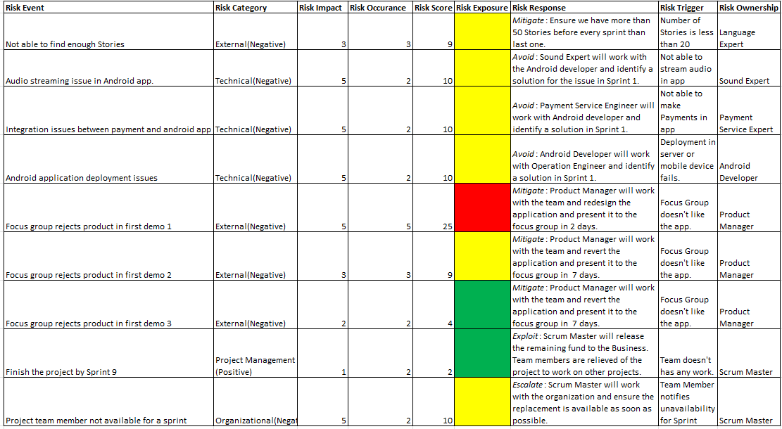
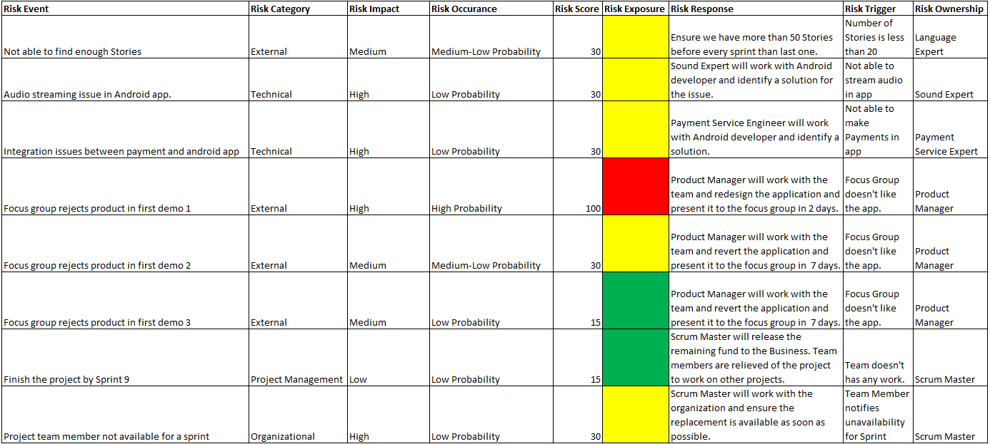
RISK
https://www.pmi.org/learning/library/risk-analysis-project-management-7070

Slide 13
SUMMARY
Officially we have kick-started the project.
Everyone understands their role and expectation in the project.
All team members have agreed upon the goals(KPIs) set in the Time slides.
All team members understand the monitoring and control in place.
All team members have agreed upon the quality metrics.
Scrum Master(me) has noted down all the concerns the team has at this point and will take it up with related personals for further clarification and provide an update in the next daily stand-up.

Slide 14
THANK YOU
Vikas Sanil​
vsanil1@hawk.iit.edu.com

